Slide 1
CS 5402 Introduction to Data Mining
Data Mining Methods - Naive Bayes
v.1.0
Perry B. Koob, koobp@mst.edu

Slide 2
What we are going to learn.
Conditional Probability
Bayes Theorem
Naive Bayes

Slide 3
Conditional Probability
edible
no odor
inedible
edible
pungent
bruised
inedible
flat
no bruise
foul
bruised
anise
convex
no bruise
fishy
bruised
knobbed
no bruise

Slide 4
Conditional Probability
p(C_{i}|x₁,x₂,x₃...x_{m})
Where C_{i} is the Class value your are interested in, x_{j} is the value of the attribute of your example, and m is the number of attributes in your example.
Example:
p(edible = yes | cap size = flat, bruised = no, odor = none)

Slide 5
Conditional Probability
Given events
Probability of
p(C_{i}|x₁,x₂,x₃...x_{p})
Where C_{i} is the Class value your are interested in, x_{i} is the value of the attribute of your example, and p is the number of attributes in your example.
Example:
p(edible = yes | cap size = flat, bruised = no, odor = none)

Slide 6
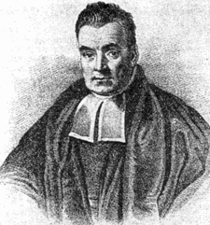
Bayes Theorem
Thomas Bayes
Born 1701 in London, England
Wrote
"An Essay towards solving a Problem in the Doctrine of Chances"
The essay proposes a solution to a problem of inverse probability.
https://en.wikipedia.org/wiki/Thomas_Bayes

Slide 7
Bayes Theorem - Inverse Probability
edible
no odor
inedible
edible
Observations.
pungent
bruised
inedible
“Urn” of unknown
contents.
flat
no bruise
foul
bruised
anise
convex
no bruise
fishy
bruised
knobbed
no bruise

Slide 8
Bayes Theorem - Inverse Probability
edible
no odor
inedible
Mushrooms we have data on.
edible
pungent
bruised
inedible
The World of Mushrooms.
flat
no bruise
foul
bruised
anise
convex
no bruise
fishy
bruised
knobbed
no bruise

Slide 9
Bayes Theorem - Inverse Probability
edible
no odor
inedible
Emails we can classify as Spam or Not Spam.
edible
pungent
bruised
inedible
flat
All the Emails
no bruise
foul
bruised
anise
convex
no bruise
fishy
bruised
knobbed
no bruise

Slide 10
Bayes Theorem
p(B|A) * p(A)
p(A|B) = ------------------------
p(B)

Slide 11
Bayes Theorem
p(x₁,x₂,x₃...x_{p}|C_{i}) * p(C_{i})
p(C_{i}|x₁,x₂,x₃...x_{p}) = ------------------------------------
p(x₁,x₂,x₃...x_{p})

Slide 12
Bayes Theorem
p(x₁,x₂,x₃...x_{m}|C_{i}) * p(C_{i})
p(C_{i}|x₁,x₂,x₃...x_{m}) = ----------------------------------------------------------------------
p(x₁,x₂,x₃...x_{m}|C₁)*p(C₁)+...+ p(x₁,x₂,x₃...x_{m}|C_{n})*p(C_{n})
Where C_{i} is the Class value your are interested in, x_{j} is the value of the attribute of your example that match the class, m is the number of attributes in you example, and n is the number of Classes.

Slide 13
Bayes Theorem
Likelihood
Class Prior Probability
p(x₁,x₂,x₃...x_{m}|C_{i}) * p(C_{i})
p(C_{i}|x₁,x₂,x₃...x_{m}) = ----------------------------------------------------------------------
p(x₁,x₂,x₃...x_{m}|C₁)*p(C₁)+...+ p(x₁,x₂,x₃...x_{m}|C_{n})*p(C_{n})
Where C_{i} is the Class value your are interested in, x_{j} is the value of the attribute of your example that match the class, m is the number of attributes in you example, and n is the number of Classes.

Slide 14
Bayes Theorem - Naive Assumption
Where Bayes Fails...
The problem comes when you encounter a combination of attributes that you have not encountered before.

Slide 15
Bayes Theorem - Naive Assumption
When using the Naive Bayes Classifier, we make the “naive” assumption that each attribute is independent of another. This is almost never the case, but we don’t care. This declaration of independence allows us to use the product of the conditional probabilities of each attribute x_{j} given C_{i} for the likelihood value.
p(x₁,x₂,x₃...x_{m}|C_{i}) = p(x₁|C_{i}) * p(x₂|C_{i})*...* p(x_{m}|C_{i})

Slide 16
Naive Bayes Classifier
Probabilistic Classifier.
Supervised Learning.
Naive Bayes Classifier uses all the attributes and not just 1 attribute like 1R.
Naive Bayes takes Nominal Inputs.
It is called “Naive” because we make the fundamental assumption that each feature makes an independent and equal contribution to the outcome.

Slide 17
Naive Bayes Classifier - Algorithm
For Class C, Attribute x
For each value
Estimate individual conditional probabilities p(x_{j} |C_{i})
Multiply these probabilities by each other to get the likelihood.
Multiply the Likelihood by the Class Prior Probability, which is the portion of records belonging to class C_{i}
Estimate a probability for Class C_{i} by taking the product of the Likelihood and Class Prior Probability for Class C_{i} and dividing it by the sum of the Likelihood and Class Prior Probability for all Class.
Choose the class the example belongs to.

Slide 18
Naive Bayes Classifier - Class Assignment Methods
Most Probable Class Method
Assign the record to the class with the highest probability.
Or
Cut Off Probability Method
Determine a Cut Off Probability at which the example will be assigned to the Class if the probability exceeds the Cut Off Probability.

Slide 19
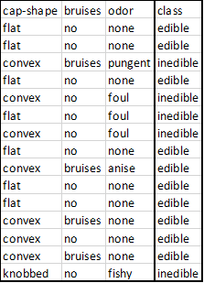
Full and Naive Bayes Classifier
Using Full and Naive Bayes on this…
p(edible = yes | cap size = flat, bruised = no, odor = none)

Slide 20
Full Bayes Classifier
For Full Bayes:
p(x₁,x₂,x₃...x_{p}|C_{i}) * p(C_{i})
p(C_{i}|x₁,x₂,x₃...x_{p}) = ------------------------------------
p(x₁,x₂,x₃...x_{p})
p(edible = yes | cap size = flat, bruised = no, odor = none)

Slide 21
Full Bayes Classifier
For Full Bayes:
p(cap size = flat, bruised = no, odor = none|edible = yes) * p(edible = yes)
p = ----------------------------------------------------------- ------------------------------------
p(cap size = flat, bruised = no, odor = none)
p(cap size = flat, bruised = no, odor = none|edible = yes) = 6/15 = 0.4

Slide 22
Full Bayes Classifier
For Full Bayes:
p(cap size = flat, bruised = no, odor = none|edible = yes) * p(edible = yes)
p = -----------------------------------------------------------------------------------------------
p(cap size = flat, bruised = no, odor = none)
p(cap size = flat, bruised = no, odor = none|edible = yes) = 6/15 = 0.4
p(edible = yes) = 10/15 = 0.67

Slide 23
Full Bayes Classifier
For Full Bayes:
p(cap size = flat, bruised = no, odor = none|edible = yes) * p(edible = yes)
p = ----------------------------------------------------------- ------------------------------------
p(cap size = flat, bruised = no, odor = none)
p(cap size = flat, bruised = no, odor = none|edible = yes) = 6/15 = 0.4
p(edible = yes) = 10/15 = 0.67
p(cap size = flat, bruised = no, odor = none) = 6/15 = 0.4
p = (0.4 * 0.67)/(0.4) = 0.67

Slide 24
Full Bayes Classifier
For Full Bayes:
p(x₁,x₂,x₃...x_{p}|C_{i}) * p(C_{i})
p(C_{i}|x₁,x₂,x₃...x_{p}) = ------------------------------------
p(x₁,x₂,x₃...x_{p})
It falls apart when we don’t have corresponding data values. Like in the following case…
p(edible = no | cap size = flat, bruised = no, odor = none)
or
p(edible = yes | cap size = flat, bruised = yes, odor = none)

Slide 25
Naive Bayes Classifier
For Naive Bayes:
p(x₁|C_{i}) *…* p(x_{n}|C_{i}) * p(C_{i})
p(C_{i}|x₁,x₂,x₃...x_{p}) = ------------------------------------
p(x₁)*p(x₂)*p(x₃)*…*p(x_{p})
We use the Naive assumption that each attribute is independent.

Slide 26
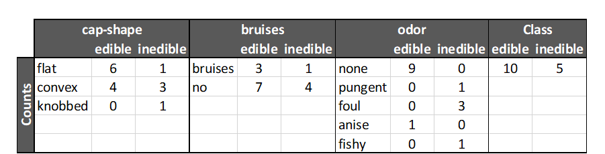
Naive Bayes Classifier
For the Naive Bayes Classifier we need to get the frequency counts.

Slide 27
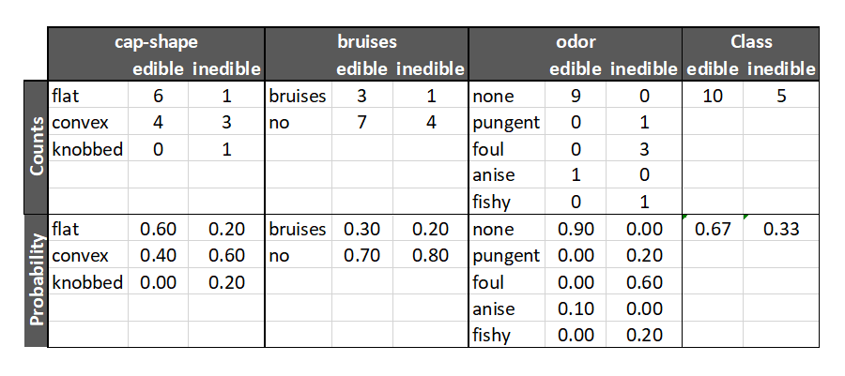
Naive Bayes Classifier
For the counts, get the probabilities.

Slide 28
Naive Bayes Classifier
For the counts, get the probabilities.
p(cap-shape = flat | Class = edible)

Slide 29
Naive Bayes Classifier
For the counts, get the probabilities.
p(cap-shape = flat | Class = inedible)

Slide 30
Naive Bayes Classifier
For the counts, get the probabilities.
p(Class = edible)
p(Class = inedible)

Slide 31
Naive Bayes Classifier
Likelihood edible = p(flat|edible) * p(no|edible) * p(none|edible)
Likelihood inedible = p(flat|inedible) * p(no|inedible) * p(none|inedible)
p = (Likelihood edible * p(edible)) / (Likelihood edible * p(edible) + Likelihood inedible * p(inedible))

Slide 32
Naive Bayes Classifier
Likelihood edible = p(flat|edible) * p(no|edible) * p(none|edible) = (0.60 *0.70 * 0.90 ) = 0.38
Likelihood inedible = p(flat|inedible) * p(no|inedible) * p(none|inedible) = (0.20 * 0.80) = 0.16
p = (Likelihood edible * p(edible)) / (Likelihood edible * p(edible) + Likelihood inedible * p(inedible))

Slide 33
Naive Bayes Classifier
Likelihood edible = p(flat|edible) * p(no|edible) * p(none|edible) = (0.60 *0.70 * 0.90 ) = 0.38
Likelihood inedible = p(flat|inedible) * p(no|inedible) * p(none|inedible) = (0.20 * 0.80) = 0.16
p = (Likelihood edible * p(edible)) / (Likelihood edible * p(edible) + Likelihood inedible * p(inedible))
Missing Values are handled by not being included in the Likelihood calculations.

Slide 34
Naive Bayes Classifier
Likelihood edible = = 0.38 Likelihood inedible = = 0.16
p = (Likelihood edible * p(edible)) / (p(flat) * p(no) * p(none))=
( 0.38 * 0.67) / ((( 0.38 * 0.67) + (0.16 * 0.33)) = .252 / (.252 + .053) = 0.252 / 0.305 = 0.825

Slide 35
Naive Bayes Classifier - Cut Off Probability
p(edible = yes | cap size = flat, bruised = no, odor = none) = 0.825
If we were using the Cut Off Probability Method, we would compare 0.825 to our Cut Off Probability Method. If our Cut Off Probability Method is 0.75, we would classify the example as Edible.

Slide 36
Naive Bayes Classifier - Cut Off Probability
p(edible = yes | cap size = flat, bruised = no, odor = none) = 0.825
If we were using the Cut Off Probability Method, we would compare 0.825 to our Cut Off Probability Method. If our Cut Off Probability Method is 0.75, we would classify the example as Edible.
p(edible = yes | cap size = flat, bruised = no, odor = none) > Cut Off
0.825 > 0.75

Slide 37
Naive Bayes Classifier - Most Probable Class
p(edible = yes | cap size = flat, bruised = no, odor = none) = 0.825
If we were using the Most Probable Class, we would compare 0.825 the probability of the other classes.
p(edible = yes | cap size = flat, bruised = no, odor = none) = 0.825
p(edible = no | cap size = flat, bruised = no, odor = none) = 0.175

Slide 38
Naive Bayes Classifier - Most Probable Class
p(edible = yes | cap size = flat, bruised = no, odor = none) = 0.825
If we were using the Most Probable Class, we would compare 0.825 the probability of the other classes.
p(edible = yes | cap size = flat, bruised = no, odor = none) = 0.825
p(edible = no | cap size = flat, bruised = no, odor = none) = 0.175
So we would classify this example as Edible.
Winner!

Slide 39
Naive Bayes Classifier - Most Probable Class
p(edible = yes | cap size = flat, bruised = no, odor = none) = 0.825
If we were using the Most Probable Class, we would compare 0.825 the probability of the other classes.
p(edible = yes | cap size = flat, bruised = no, odor = none) = 0.825
p(edible = no | cap size = flat, bruised = no, odor = none) = 0.175
So we would classify this example as Edible.
Works with multiple classes.
Winner!

Slide 40
Bayes Classifier when no data is present?
What happens if we wanted to know
p(edible = yes | cap size = flat, bruised = yes, odor = none) ?
p(A|B) = ( p(B|A) * p(A) ) / p(B)
If we were using Full Bayes, the p = ( 0 * 0.67 ) / (0) = Undefined
If we were using Naive Bayes, the p = 0.89

Slide 41
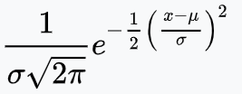
Bayes Classifier when using Interval or Ratio data
When we use Naive Bayes Classifiers on Interval or Ratio attribute, x, we assume that x is normally distributed and use a Probability Density Function for Normally distributed data to determine the probabilities of P(x|C).
p(x|C) = p(x)=

Slide 42
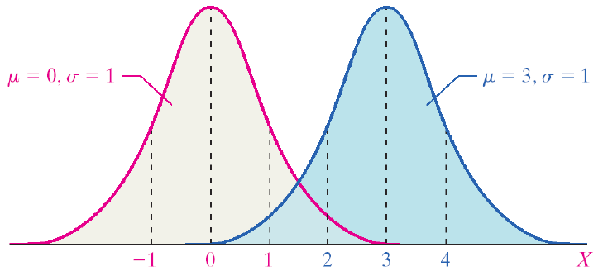
Bayes Classifier when using Interval or Ratio data
For each Class value we calculate the sample mean 𝜇 and the sample standard deviation 𝜎.
https://courses.lumenlearning.com/suny-natural-resources-biometrics/chapter/chapter-1-descriptive-statistics-and-the-normal-distribution/

Slide 43
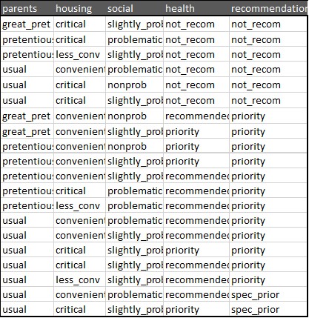
Multiclass Naive Bayes

Slide 44
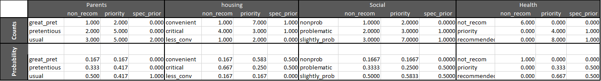
Multiclass Naive Bayes

Slide 45
Multiclass Naive Bayes
p(non_recom|parents = pretentious)

Slide 46
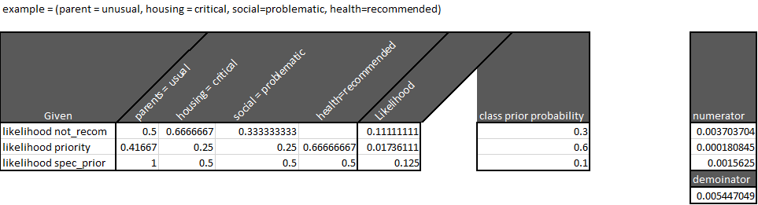
Multiclass Naive Bayes

Slide 47
Multiclass Naive Bayes

Slide 48
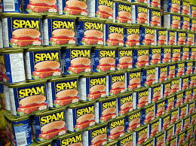
Naive Bayes Classifier - Spam Filters
Full Bayes and Naive Bayes Classifiers are used as Spam filters since 1990’s.
A Spam filter that has been implemented with Naive Bayes Classifiers would use a selection of words from an email messages as attributes.
Individuals can training their spam filters by
marking Spam messages that make it through
the filter as Spam.

Slide 49
Naive Bayes Classifier - Documents
For Naive Bayes Classifiers when working with documents, the attributes are the words in the document.
For each word, P(x|C), you can record them as a binary value marking whether the word is in the document of not.

Slide 50
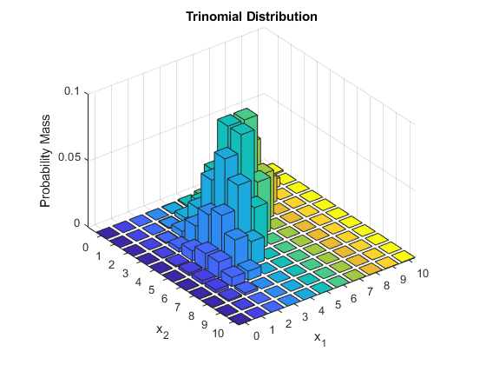

Naive Bayes Classifier - Documents
Or you can get a word frequency count and treat the words as if they were Multinomially distributed and use the Multinomial Probability Mass Function to the probabilities of p(x|C).
p(x|C) = p(x) =
https://en.wikipedia.org/wiki/Multinomial_distribution
https://www.mathworks.com/help/stats/mnpdf.html

Slide 51
What we covered.
Conditional Probability
Bayes Theorem
Naive Bayes

Slide 52
References
Sahami, M., Dumais, S., Heckerman, D., & Horvitz, E. (1998, July). A Bayesian approach to filtering junk e-mail. In Learning for Text Categorization: Papers from the 1998 workshop (Vol. 62, pp. 98-105).
Shmueli, G., Bruce, P. C., Yahav, I., Patel, N. R., & Lichtendahl Jr, K. C. (2017). Data mining for business analytics: concepts, techniques, and applications in R. John Wiley & Sons.
Witten, I. H., Frank, E., Hall, M. A., & Pal, C. J. (2016). Data Mining: Practical Machine Learning Tools and Techniques.

